Slide 1
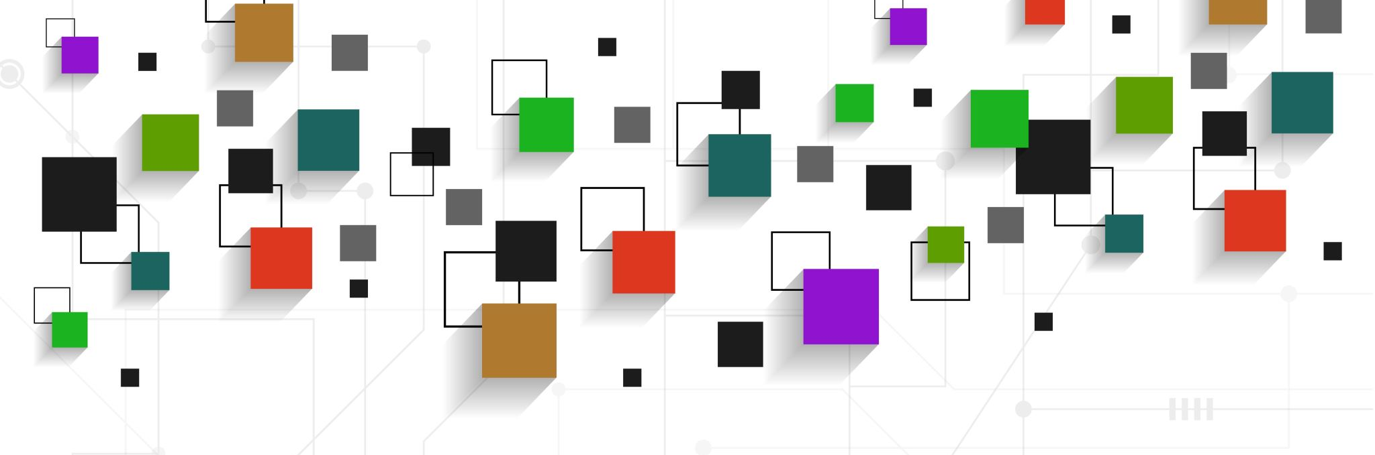
Chicago crime - Dataset
This dataset reflects reported incidents of crime that occurred in the City of Chicago from 2011 to 2020
Harika Peddiraju - Ulises Domínguez - Yuting Chien - Karla Flores

Slide 2
Topic and Description
Topic: Data displaying of crime in Chicago City
Using historical crime data from the Chicago Police Department, we aim to display yearly information on the number of crimes by type, arrest, and location of each event.
Data source
City of Chicago Data Portal - Police Department
https://data.cityofchicago.org/Public-Safety/Crimes-2001-to-Present/ijzp-q8t2
Notes:
Yuting

Slide 3
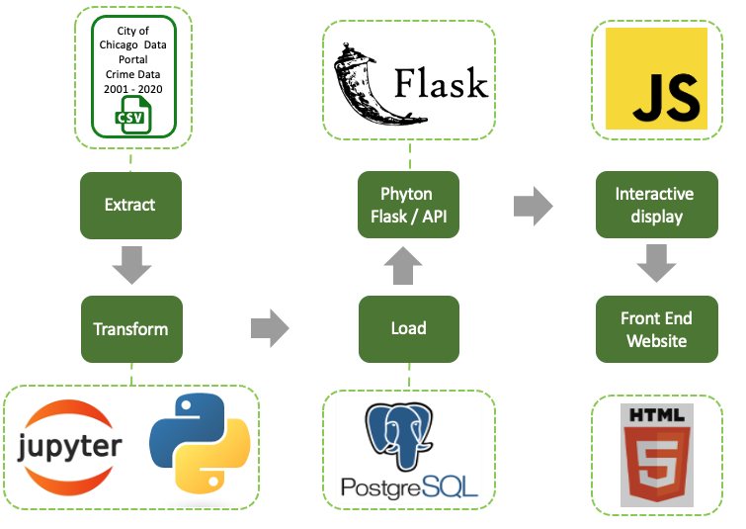
Code crafting
Extract and Transform Crime data
Dataset with 7.5M records
Jupyter notebook
Munging data into Database: SQL
SQLAlchemy
Notes:
Ulises
We started with 7.5 million records
Reduced to 2.8 million
SQLAlchemy to run flask and create the API calls

Slide 4
Code crafting (CONT)
3. Flask app hosts our API endpoints - app.py
/api/v1.0/dashboard
/api/v1.0/year/<year>
/api/v1.0/monthly/<year>/<primary_type>
/api/v1.0/<year>/<primary_type>
4. Modeling data in JavaScript - app.js
Notes:
Karla
/api/v1.0/dropdown - for feeding our dropdown with the year and crime type.
/api/v1.0/year/<year> - for selecting yearly information such as the count of type of crime monthly and the count of arrest by crime type.
/api/v1.0/monthly/<year>/<primary_type> - for separating the arrest count by month.
/api/v1.0/<year>/<primary_type> - for choosing a specific year and crime type that will feed our leaflet map

Slide 5

Tell the story with data
Displaying data - create an interactive dashboard that displays a map with the amount of crimes by type, along with a 3 graphs set.
Crime type in a specific year by month.
Arrests and not arrests by month over the year - Line Chart using JS library: Chart.js
Total amount of arrests versus not arrests.
User-Driven Interaction: Dropdowns
Notes:
Ulises

Slide 6
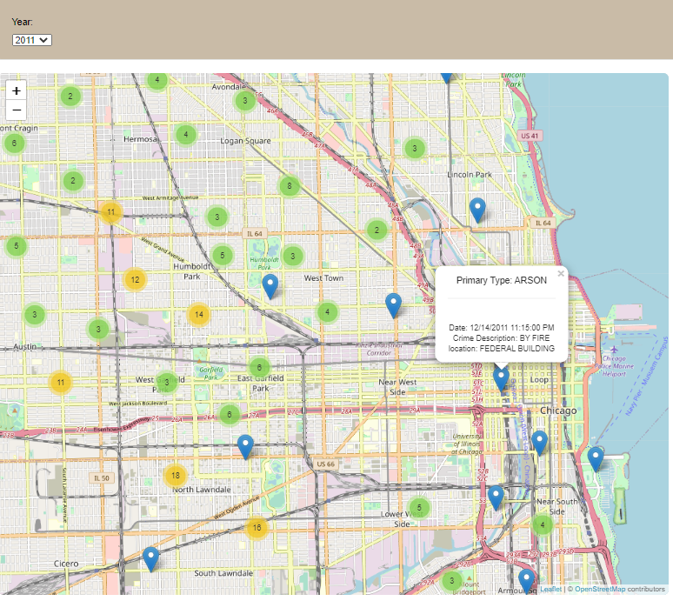
Dashboard
Notes:
Harika

Slide 7
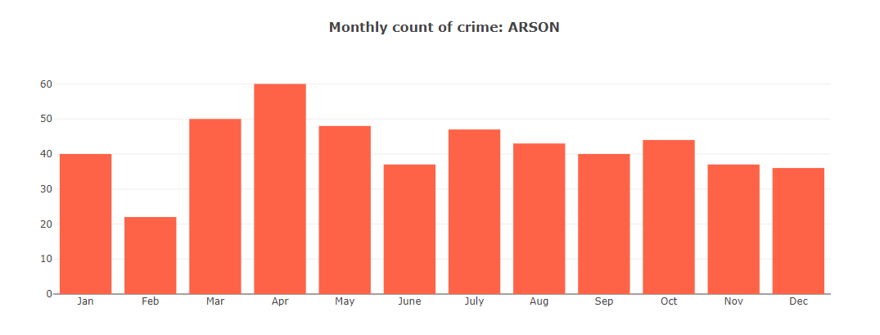
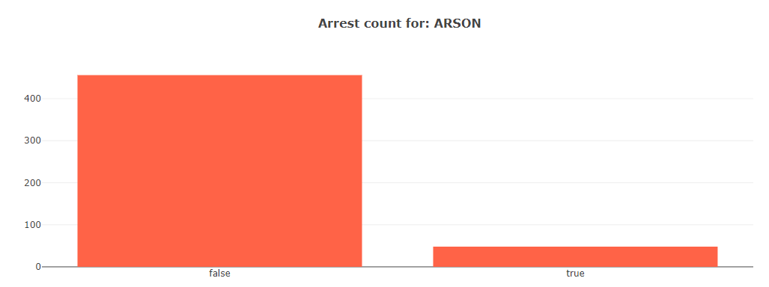
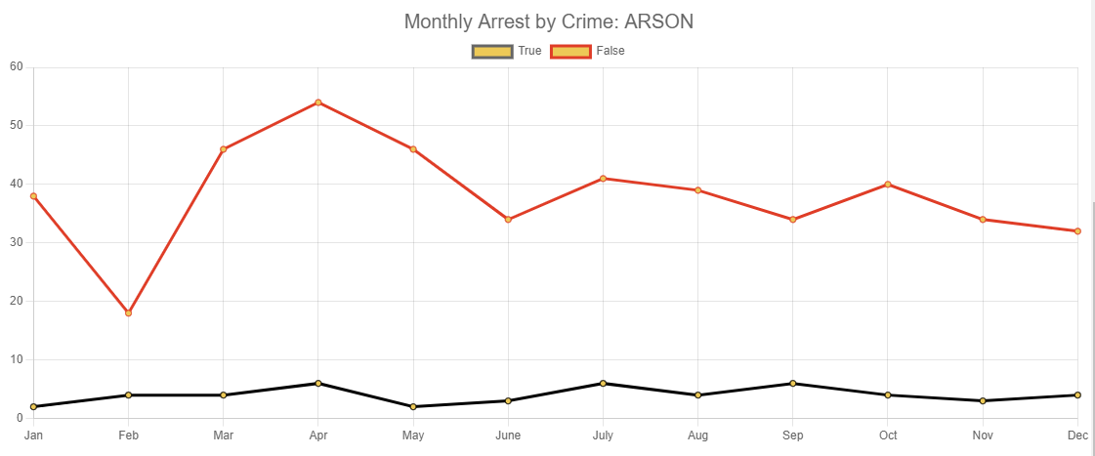
Dashboard
Notes:
Harika

